Slide 1

BASIC JAVA CLASS-3
INSTRUCTOR
SALMAN RAHMAN
ROAD TO SDET

Slide 2
CONTENTS
Function
Array

Slide 3
Create and call a function
How can you call a function in main method?
Create the object of that class and call the method inside the main method. Example code:
[ Always try to keep the first letter of a class name as capital and first letter of a variable / function name as small letter. ]
public class BasicMethods {
public static void main(String[] args) {
BasicMethods basic = new BasicMethods();
basic.sayHello();
}
public void sayHello(){
System.out.println("Hello world");
}
}

Slide 4
Passing an argument
public class BasicMethods {
public static void main(String[] args) {
BasicMethods basic = new BasicMethods();
basic.sayHello("Ashraful");
}
public void sayHello(String str){
System.out.println("Hello "+str);
}
}

Slide 5
Return type of method
public class BasicMethods {
public static void main(String[] args) {
BasicMethods basic = new BasicMethods();
int answer = basic.sayHello(5 , 10);
System.out.println(answer);
}
public int sayHello(int a , int b){
int sum = a+b;
return sum;
}
}

Slide 6
Check Prime method
public class BasicMethods {
public static void main(String[] args) {
Scanner sc = new Scanner(System.in);
int val = sc.nextInt();
BasicMethods basic = new BasicMethods();
boolean check = basic.checkPrime(val);
if(check == true)
System.out.println("The number is prime");
else
System.out.println("The Number is not prime");
}

Slide 7
Check Prime method (Part 2)
public boolean checkPrime(int num){
boolean flag = true;
for (int i = 2; i <num; i++) {
if (num % i == 0) {
flag = false;
break;
}
}
return flag;
}
}

Slide 8
Check Prime number between 1 to 100
public static void main(String[] args) {
BasicMethods basic = new BasicMethods();
for(int i=2 ; i<= 100 ; i++) {
boolean check = basic.checkPrime( i );
if (check == true)
System.out.println("The number "+ i +" is prime");
}
}
// checkPrime Method will be same as previous example

Slide 9
FUNCTION/METHOD
public static DataType staticFuncName();
callFunction(){
staticFuncName();
}
public DataType funcName(String s1, String s2);
callFunction(){
ClassName obj=new ClassName();
Obj.funcName();
}

Slide 10
Factorial of a number Explanation
factorial(4) = 4 * factorial(3)
factorial(3) = 3 * factorial(2)
factorial(2) = 2 * factorial(1)
factorial(1) = 1
Time complexity: O(n)
1! = 1
2! = 2*1 = 2 * 1!
3! = 3 * 2 * 1 = 3 * 2!
4! = 4 * 3 * 2 * 1 = 4 * 3!
So , f(n) = n! = n * (n-1)!

Slide 11
Factorial using Iteration
public static void main(String[] args) {
System.out.println( factorial(4) );
}
public static int factorial(int n){
int fact = 1;
for( int i=1 ; i<=n ; i++ )
fact = fact*i;
return fact;
}

Slide 12
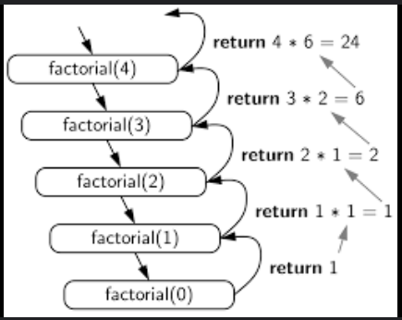
Recursion [ Recursion means self calling function ]
public class Recursion {
public static void main(String[] args) {
System.out.println( factorial(4) );
}
public static int factorial(int n){
if(n==0){
return 1;
}
return n * factorial(n-1) ;
}
}

Slide 13
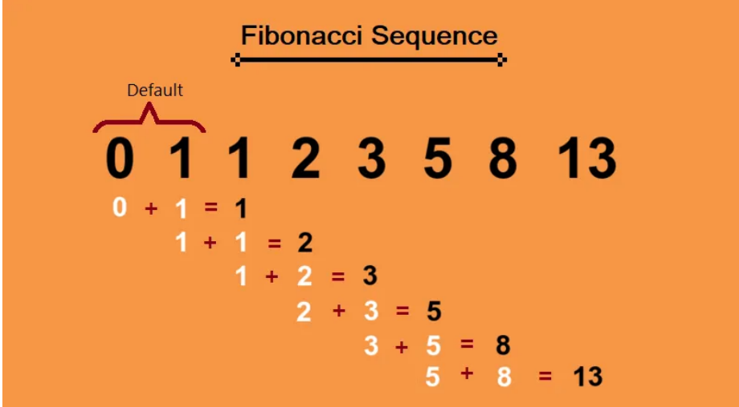
Calculate Fibonacci series till the nth position by using recursion

Slide 14
Time complexity
Time complexity | Title | Description
O(1) | Array Element Access | Accessing an element in an array is constant time because you can directly access any element by its index.
O(n) | Simple Loop Over an Array | A single loop over an array is linear time, as you need to visit each element once
O(n²) | Nested Loops Over a 2D Array | A nested loop over a 2D array results in quadratic time complexity.
O(log n) | Binary Search | Binary search is logarithmic because the search space is halved with each iteration.
O(n log n) | Merge Sort, Quick Sort, Heap Sort | Merge sort has a time complexity of O(n log n) due to the repeated splitting and merging of subarrays.

Slide 15
ARRAY
Single dimensional array (1D)
Multi dimensional array (2D,3D)

Slide 16
1D ARRAY
DataType[] myArray=new DataType[length];
myArray[n1];
myArray[n2];
myArray[n3];
DataType[] myArray={n1,n2,n3,…..n};

Slide 17
ARRAY EXAMPLE
int[] num=new int[5]; num[0]=1; num[1]=2; num[2]=3; num[3]=4; num[4]=5; for(int i=0;i<5;i++){ System.out.println(num[i]); }
int[] num={1,2,3,4,5}; System.out.println(num[0]);

Slide 18
FOREACH LOOP
public static void main(String[] args) {
String[] fruits={"Mango","Banana","Litchi"};
for (String fruit: fruits) {
System.out.println("I love "+fruit);
}
}

Slide 19
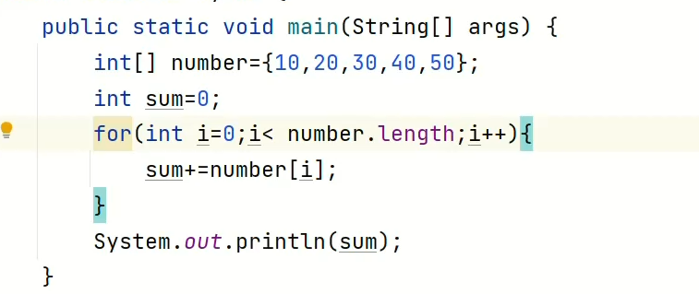
Calculate sum of values in an array

Slide 20
Find max and min from the array
public static void main(String[] args) {
int[] numbers = {5, 9, 10, 6, 7};
int max= findMax(numbers);
System.out.println(max);
}
public static int findMax(int[] numbers){
int max=numbers[0];
for(int i=0;i<numbers.length;i++){
if(numbers[i]>max){
max=numbers[i];
}
}
return max;
}

Slide 21
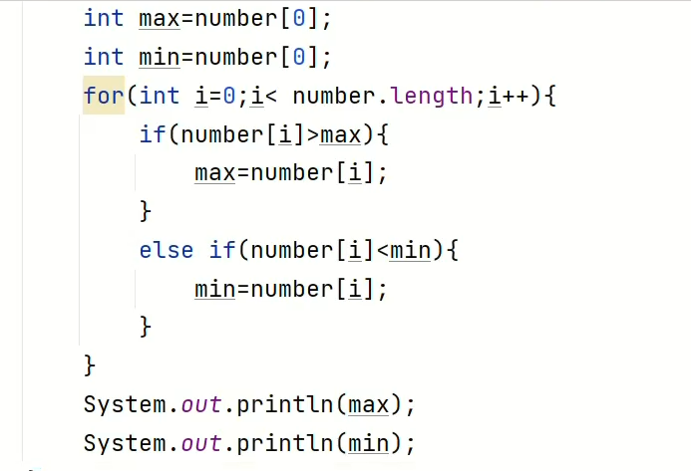
Find max and min in array

Slide 22
Find out second max number from array
public static void main(String[] args) { int[] numbers = { 5 ,3 , 7 , 1, 6 , 2 }; int max, secondMax; max = numbers[0]; secondMax = numbers[0]; for(int i=0;i< numbers.length;i++){ if(numbers[i]>max){ secondMax = max; max = numbers[i]; } else if(numbers[i] > secondMax && numbers[i]<max) secondMax = numbers[i]; } System.out.println(secondMax); }

Slide 23
2D ARRAY
DataType[][] arr={{n1,n2,n3},{n4,n5,n6},{n7,n8,n9}};

Slide 24
2D ARRAY EXAMPLE
public static void main(String[] args) { int[][] arr = {{1, 2}, {3, 4}}; for (int i = 0; i < 2; i++) for (int j = 0; j < 2; j++){ System.out.println("arr[" + i + "][" + j + "] = " + arr[i][j]); } }

Slide 25
Find a given element is exists in array (Linear Searching)
public class NumberExistsInArray {
public static void main(String[] args) {
int[] numbers = { 1, 2, 3, 4, 5 };
int number = 9;
boolean found = false;
for (int i = 0; i < numbers.length; i++) {
if (numbers[i] == number) {
found = true;
break;
}
}
if (found) {
System.out.println(number + " is found.");
} else {
System.out.println(number + " is not found.");
}
}
}

Slide 26
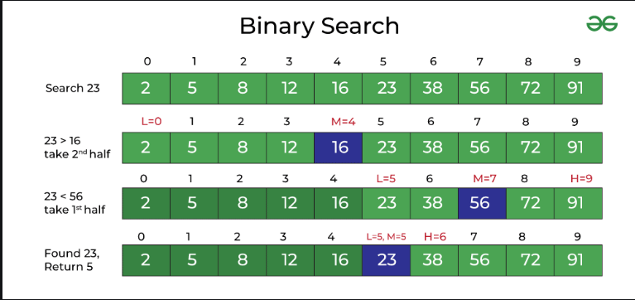
Binary Search Theory For Binary Search , the given array must be sorted.

Slide 27
Binary searching
public class BinarySearch {
public static int binarySearch(int[] arr, int target) {
int left = 0;
int right = arr.length - 1;
while (left <= right) {
int mid = left + (right - left) / 2;
if (arr[mid] == target)
return mid;
else if (arr[mid] < target)
left = mid + 1;
else
right = mid - 1;
}
return -1;
}
}

Slide 28
ARRAY PROGRAMS
Print all elements from an array
Find the only even numbers in array
Find the sum of all elements from a given array
Find the max and min number from a given array
Find the second largest number
Sort numbers in ascending and descending from an array
Shuffle Array numbers
Find the duplicate element in array
Find if a given element is exist in the array
Find the number of notes from input amount in given array
[1000,500,200, 100,50,20,10,5,2, 1]

Slide 29
Find duplicate numbers in array
public static void main(String[] args) {
int[] numbers = { 1, 2, 3, 5 , 4, 2 , 4 , 1, 2 };
for(int i=0;i< numbers.length;i++){
for(int j=i+1;j< numbers.length;j++){
if(numbers[i]==numbers[j]){
System.out.println(numbers[i]);
}
}
}
}

Slide 30
Sort Array in ascending order
public static void main(String[] args) {
int[] arr = new int[]{78, 35, 1, 3, 90, 34, 6, 55, 20};
for (int i = 0; i <= arr.length-1; i++) {
for (int j = i + 1; j <= arr.length-1; j++) {
if (arr[i] > arr[j]) {
int tmp = arr[i];
arr[i] = arr[j];
arr[j] = tmp;
}
}
}
System.out.println(Arrays.toString(arr));
}

Slide 31
ARRAY SORT [Method-2]
public void arraySort(){ int[] numbers={100,80,99,56,62,24,39,40,17}; Arrays.sort(numbers); for(int i=0;i<numbers.length;i++){ System.out.println(numbers[i]); } }

Slide 32
Shuffle Array
public static void main(String[] args) {
int[] numbers = {50, 80, 92, 15, 61, 10 ,78, 28, 44};
Random random=new Random();
for(int i=0;i<numbers.length;i++){
int index= random.nextInt(numbers.length);
int temp = numbers[index];
numbers[index] = numbers[i];
numbers[i] = temp;
}
System.out.println(Arrays.toString(numbers));
}

Slide 33
Find duplicate numbers count

Slide 34
ARRAYLIST
public static void main(String[] args) { ArrayList fruits = new ArrayList(); fruits.add("Mango"); fruits.add("Banana"); fruits.add("Litchi"); fruits.add("Jackfruit"); fruits.add("Guava"); System.out.println(fruits.get(1)); //Banana String[] arr= fruits.toArray(new String[0]); //converting arraylist to array System.out.println(arr.length); System.out.println(arr[0]); }

Slide 35
Hashset
public class Main {
public static void main(String[] args) {
HashSet<String> cars = new HashSet<String>();
cars.add("Volvo");
cars.add("BMW");
cars.add("Ford");
cars.add("BMW");
cars.add("Mazda");
System.out.println(cars);
}
}
//cars.contains("Mazda"); //to check if element exists
//cars.remove("Volvo");

Slide 36
Find unique values in an array
public static void main(String[] args) {
int[] numbers = {8, 7, 8, 9, 9, 5, 0, 1};
HashSet<Integer> hashSet = new HashSet();
for (int c : numbers) {
hashSet.add(c);
}
System.out.println(hashSet);
}

Slide 37
HASHMAP
public static void main(String[] args) {
HashMap<String, String> capitalCities = new HashMap<String, String>();
// Add keys and values (Country, City)
capitalCities.put("England", "London");
capitalCities.put("Germany", "Berlin");
capitalCities.put("Norway", "Oslo");
capitalCities.put("USA", "Washington DC");
System.out.println(capitalCities); {England: London}
System.out.println(capitalCities.get("USA"));
System.out.println(capitalCities.containsKey("USA"));
}

Slide 38
How to find duplicate values?

